Slide 1
Implementation TCP-like protocol within UDP data
Group-5
S.No | Name | Registration Number | Class & Section
1. | M. Lokesh | AP18110010281 | CSE-E
2. | Y. Tarun Sai | AP18110010469 | CSE-H
3. | B.V.S. Neeraj | AP18110010474 | CSE-H
4. | M. Sri Krishna Kumar | AP18110010506 | CSE-H

Slide 2
Description
In this project we have implemented a TCP - like protocol with UDP data.
Both the TCP and UDP are transport layer protocols. The key difference between the TCP and UDP is that TCP is a connection – oriented protocol, and UDP is a connectionless protocol.
To implement the process we used server client model.

Slide 3
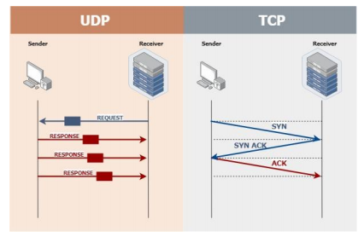
The UDP packet starts its communication process by gathering the data in a UDP packet and then adds the corresponding packet’s header information.
The communication over TCP happens by implementing a “three – way handshake” between the server/host system and the client/receiver system.

Slide 4
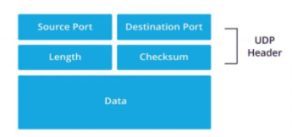
The imitation of TCP - like protocol happens in UDP data part of the UDP packet.
As UDP packet is transmitted from the server to client, the cost of overhead is minimal, as a result packets can be transmitted in quick succession.
UDP PACKET

Slide 5
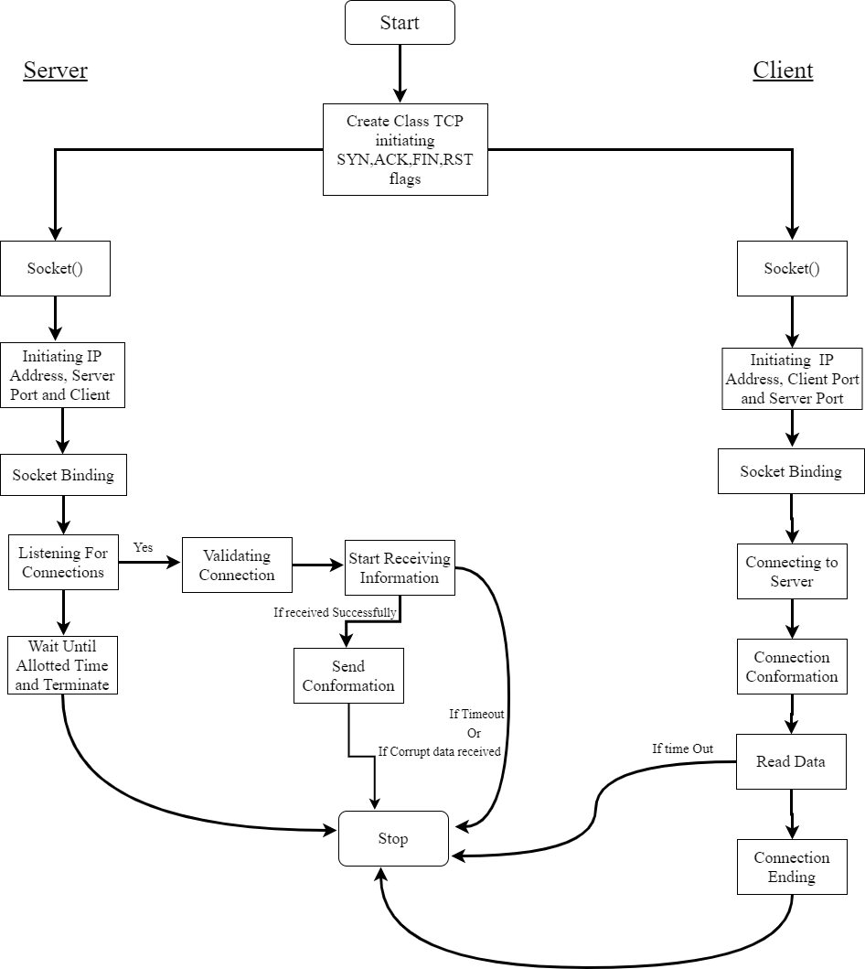
Flow chart

Slide 6
Implementation
While implementing the project we had developed a server - client model which basically transmits a UDP Packet.
In the UDP Packet the TCP - like protocol is implemented. On the server side, the data/input is entered into a notepad.
The data that is entered into the notepad on the server will be successfully transmitted to a separate/new notepad which is defined on the Client side.

Slide 7
Thank You

